Slide 1
Tijek kristalizacije u trokomponentnom sustavu CaO-Al₂O₃-SiO₂
Inženjerstvo mineralnih veziva 14.01.2021.

Slide 2
Očitavanje sastava u trokomponentnom faznom dijagramu CaO-Al₂O₃-SiO₂
Kongruentno i inkongruentno taljenje
Eutektičke i peritektičke točke
Ravnotežni trokomponentni podsustavi
Polja primarne kristalizacije faza

Slide 3
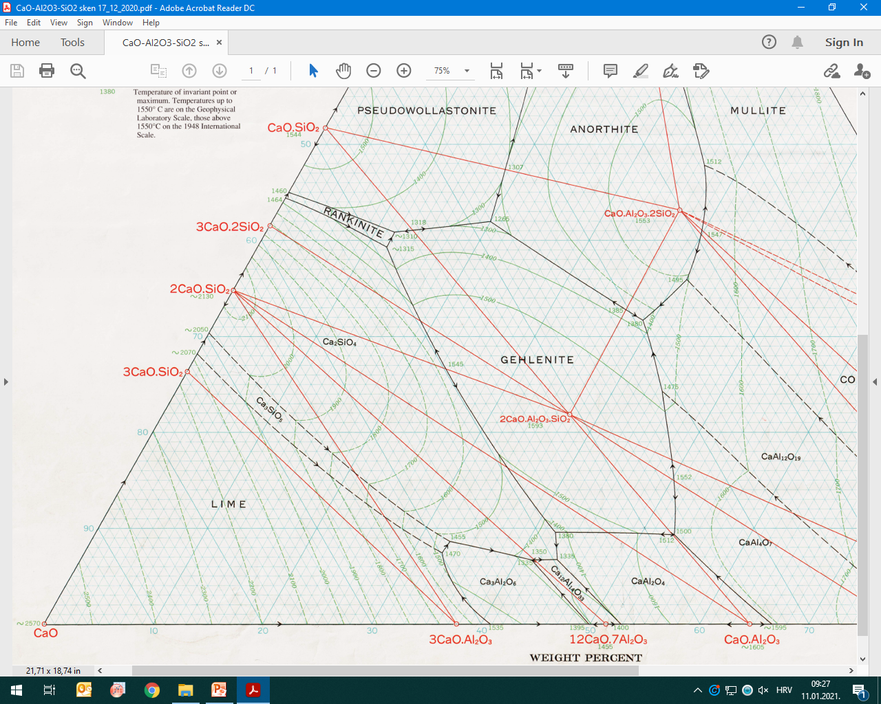
E
.
Peritektička točka pri 1380 °C
Sastav: 48.3% mas. CaO
42.1% mas. Al₂O₃
9.6% mas. SiO₂
P
Eutektička točka pri 1335 °C
Sastav: 49.5% mas. CaO
43.7% mas. Al₂O₃
6.8% mas. SiO₂
P
.
.
.
E
.
P
.
E

Slide 4
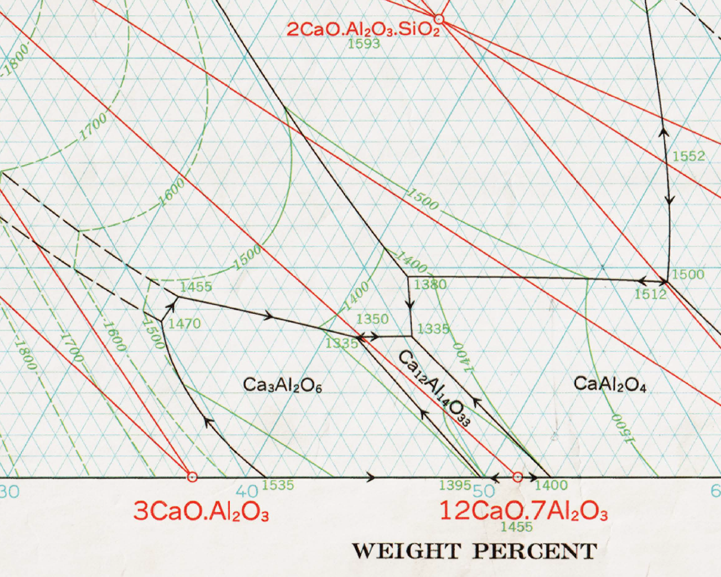
Pravilo poluge za određivanje masenog udjela mineralnih faza
S₂ 42%CaO 15%SiO₂ 43%Al₂O₃
S 46%CaO 12%SiO₂ 42%Al₂O₃
S₁ 58%CaO 3%SiO₂ 39%Al₂O₃
. S₂
S .
S₁ .

Slide 5
Bilanca tvari (očuvanje mase nekog oksida, primjerice CaO, Al₂O₃ ili SiO₂) m-masa, w-maseni udio oksida
m₁w₁ + m₂w₂ = m_{uk}w
m₁w₁ + m₂w₂ = (m₁+m₂)w
m₁w₁ + m₂w₂ = m₁w + m₂w
m₁(w₁ – w) = m₂(w – w₂)
KRAK 1
KRAK 2

Slide 6
Primjer primjene pravila poluge za određivanje masenog udjela mineralnih faza

Slide 7
C₁₂A₇-CA-C₂S
w(CA)=(A…o)/(A…CaO.Al₂O₃)
w(C₁₂A₇=(B…o)/(B…12CaO.7Al₂O₃)
w(C₂S)=(C…o)/(C…2CaO.SiO₂)
45% CaO
52% Al₂O₃
3% SiO₂
P
.
.
. B
E
A .
o
.^{C}

Slide 8
Primjer određivanja masenog udjela mineralnih faza na temelju poznatog/zadanog kemijskog sastava (bilanca tvari, sustav linearnih jednadžbi)

Slide 9
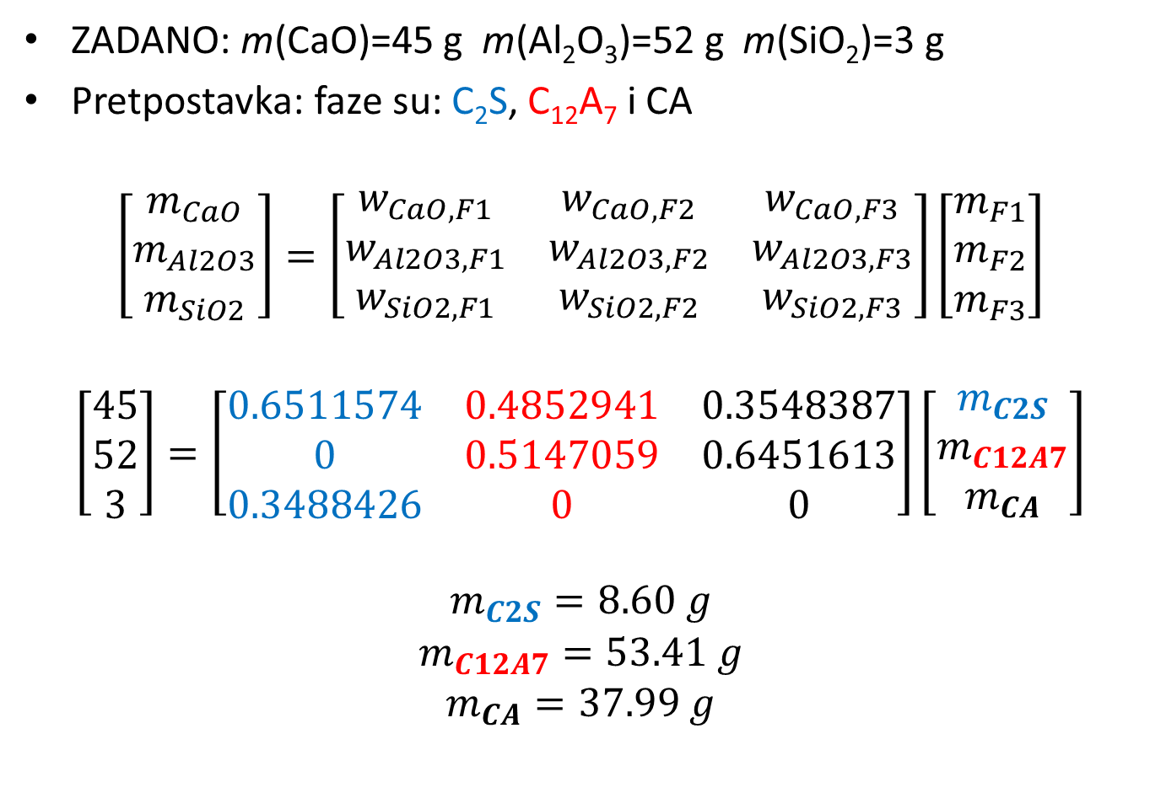
Matrični zapis…
ZADANO: m(CaO)=45 g m(Al₂O₃)=52 g m(SiO₂)=3 g
Pretpostavka: faze su: C₂S, C₁₂A₇ i CA
$$\left[\begin{matrix}m_{CaO} \\ m_{Al2O3} \\ m_{SiO2}\end{matrix}\right]=\left[\begin{matrix}w_{CaO,F1} & w_{CaO, F2} & w_{CaO,F3} \\ w_{Al2O3,F1} & w_{Al2O3,F2} & w_{Al2O3,F3} \\ w_{SiO2,F1} & w_{SiO2,F2} & w_{SiO2,F3}\end{matrix}\right]\left[\begin{matrix}m_{F1} \\ m_{F2} \\ m_{F3}\end{matrix}\right]$$
$$\left[\begin{matrix}45 \\ 52 \\ 3\end{matrix}\right]=\left[\begin{matrix}0.6511574 & 0.4852941 & 0.3548387 \\ 0 & 0.5147059 & 0.6451613 \\ 0.3488426 & 0 & 0\end{matrix}\right]\left[\begin{matrix}m_{C2S} \\ m_{C12A7} \\ m_{CA}\end{matrix}\right]$$
$$\begin{matrix}m_{C2S}=8.60 g \\ m_{C12A7}=53.41 g \\ m_{CA}=37.99 g\end{matrix}$$

Slide 10
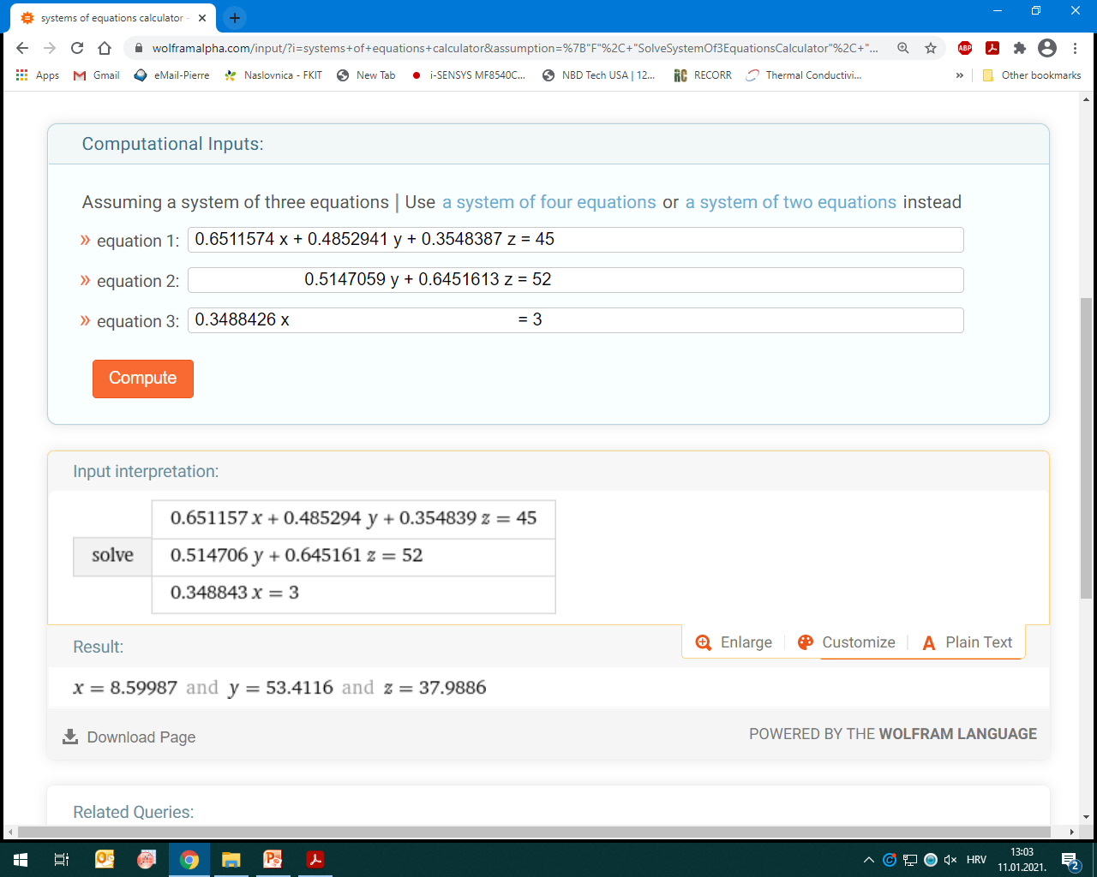

Slide 11
Tijek kristalizacije, zadani sastav nalazi se u polju primarne kristalizacije CaAl₂O₄ (s).

Slide 12
C₁₂A₇-CA-C₂S
T>≈1460 °C (talina tj. liquid)
T≈1430 °C (L + CaO.Al₂O₃(s))
w(CaO.Al₂O₃ (s), 1430°C)=(L…o)/(L…CaO.Al₂O₃)
w(CaO.Al₂O₃ (s), 1430°C)=13.78%
w(L, 1430°C)=(CaO.Al₂O₃…o)/(CaO.Al₂O₃…L)
w(L, 1430°C)=86.22%
46.5% CaO
50% Al₂O₃
3.5% SiO₂
45% CaO
52% Al₂O₃
3% SiO₂
.
E
L .
o

Slide 13
C₁₂A₇-CA-C₂S
T>1460 °C (talina tj. liquid)
T=1400 °C (L + CaO.Al₂O₃(s))
w(CaO.Al₂O₃ (s), 1400°C)=(L…o)/(L…CaO.Al₂O₃)
w(CaO.Al₂O₃ (s), 1400°C)=24.22%
w(L, 1400°C)=(CaO.Al₂O₃…o)/(CaO.Al₂O₃…L)
w(L, 1400°C)=75.78%
48% CaO
48% Al₂O₃
4% SiO₂
45% CaO
52% Al₂O₃
3% SiO₂
.
E
L .
o

Slide 14
C₁₂A₇-CA-C₂S
T>1460 °C (talina tj. liquid)
T ≈ 1370 °C (L + CaO.Al₂O₃(s))
w(CaO.Al₂O₃ (s), 1370°C)=(L…o)/(L…CaO.Al₂O₃)
w(CaO.Al₂O₃ (s), 1370°C)=28.13%
w(L, 1370°C)=(CaO.Al₂O₃…o)/(CaO.Al₂O₃…L)
w(L, 1370°C)=71.87%
45% CaO
52% Al₂O₃
3% SiO₂
48.7% CaO
47.1% Al₂O₃
4.2% SiO₂
.
E
. L
o

Slide 15
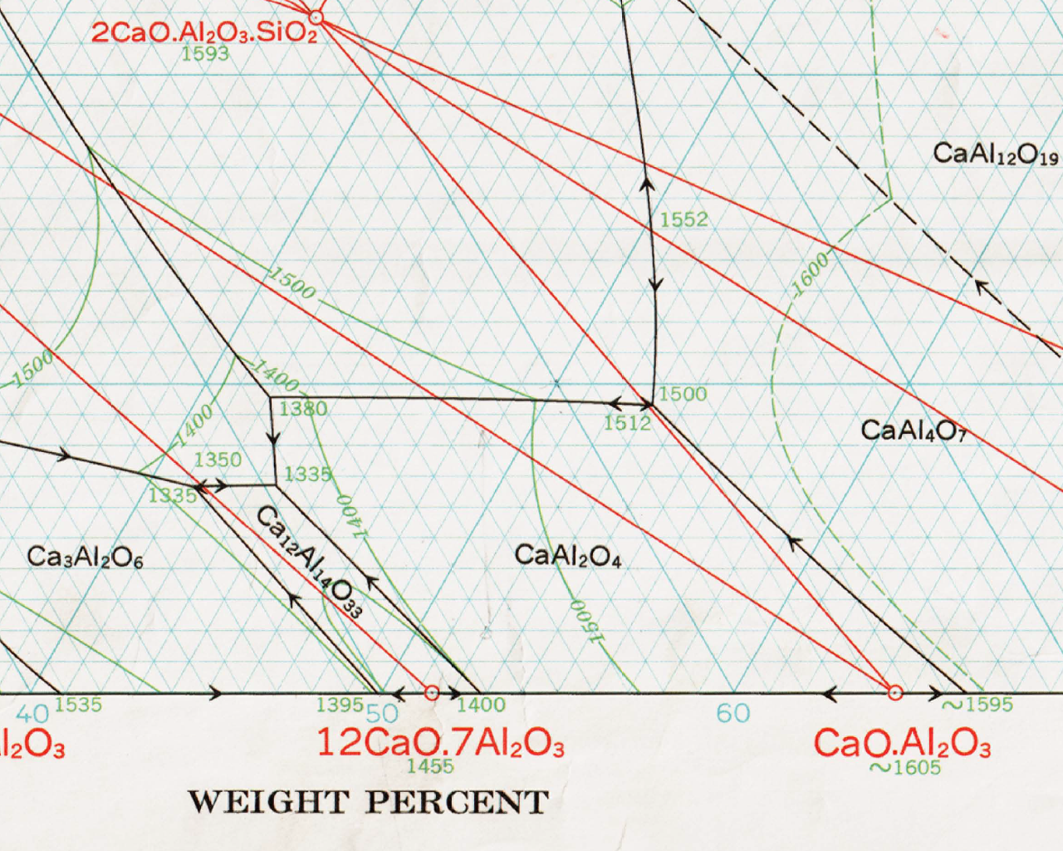
≈ 1370 °C→T→1335 °C (eutektik!)
Sastav eutektika: 49.5% mas. CaO, 43.7%mas. Al₂O₃ i 6.8% mas. SiO₂
T<1370°C
L + CaAl₂O₄ (s) + C₁₂A₇(s)
5% SiO₂
46% Al₂O₃
49% CaO
Ravnotežno hlađenje početne taline „o” završava
u eutektičkoj točci pri temperaturi od 1335 °C
4.2% SiO₂
47.1% Al₂O₃
48.7% CaO
E.
3% SiO₂
52% Al₂O₃
45% CaO
L .
.
o

Slide 16
≈1370 °C→T→1335 °C (eutektik!)
Sastav eutektika: 43.7%mas. Al₂O₃, 49.5% mas. CaO i 6.8% mas. SiO₂
T<≈1370°C
L + CaAl₂O₄ (s) + C₁₂A₇(s)
Primjenom pravila poluge moguće je odrediti maseni udio CA(s), C₁₂A₇(s) i taline L.
Početni sastav „o” nalazi se unutar trokuta
C₁₂A₇-L-CA.
49% CaO
46% Al₂O₃
5% SiO₂
E.
45% CaO
52% Al₂O₃
3% SiO₂
.L
Teškoće s preciznim određivanjem
moguće je izbjeći ako iskoristimo
činjenicu da točka •X pokazuje omjer
mase CaO.Al₂O₃ i L !
.
.X
o

Slide 17
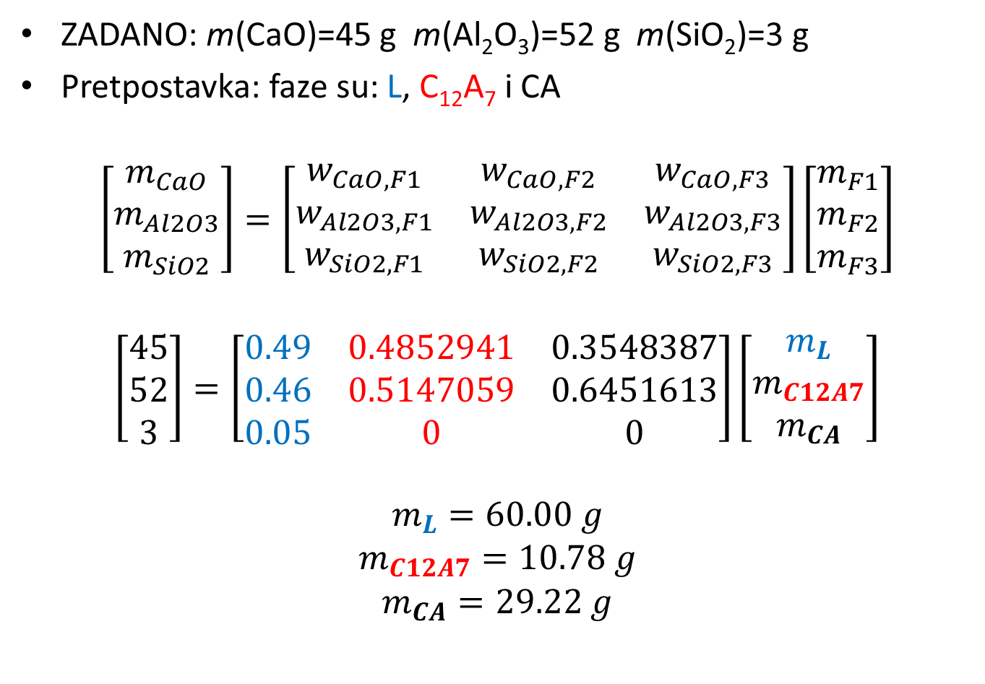
Matrični zapis…
ZADANO: m(CaO)=45 g m(Al₂O₃)=52 g m(SiO₂)=3 g
Pretpostavka: faze su: L, C₁₂A₇ i CA
$$\left[\begin{matrix}m_{CaO} \\ m_{Al2O3} \\ m_{SiO2}\end{matrix}\right]=\left[\begin{matrix}w_{CaO,F1} & w_{CaO, F2} & w_{CaO,F3} \\ w_{Al2O3,F1} & w_{Al2O3,F2} & w_{Al2O3,F3} \\ w_{SiO2,F1} & w_{SiO2,F2} & w_{SiO2,F3}\end{matrix}\right]\left[\begin{matrix}m_{F1} \\ m_{F2} \\ m_{F3}\end{matrix}\right]$$
$$\left[\begin{matrix}45 \\ 52 \\ 3\end{matrix}\right]=\left[\begin{matrix}0.49 & 0.4852941 & 0.3548387 \\ 0.46 & 0.5147059 & 0.6451613 \\ 0.05 & 0 & 0\end{matrix}\right]\left[\begin{matrix}m_{L} \\ m_{C12A7} \\ m_{CA}\end{matrix}\right]$$
$$\begin{matrix}m_{L}=60.00 g \\ m_{C12A7}=10.78 g \\ m_{CA}=29.22 g\end{matrix}$$

Slide 18
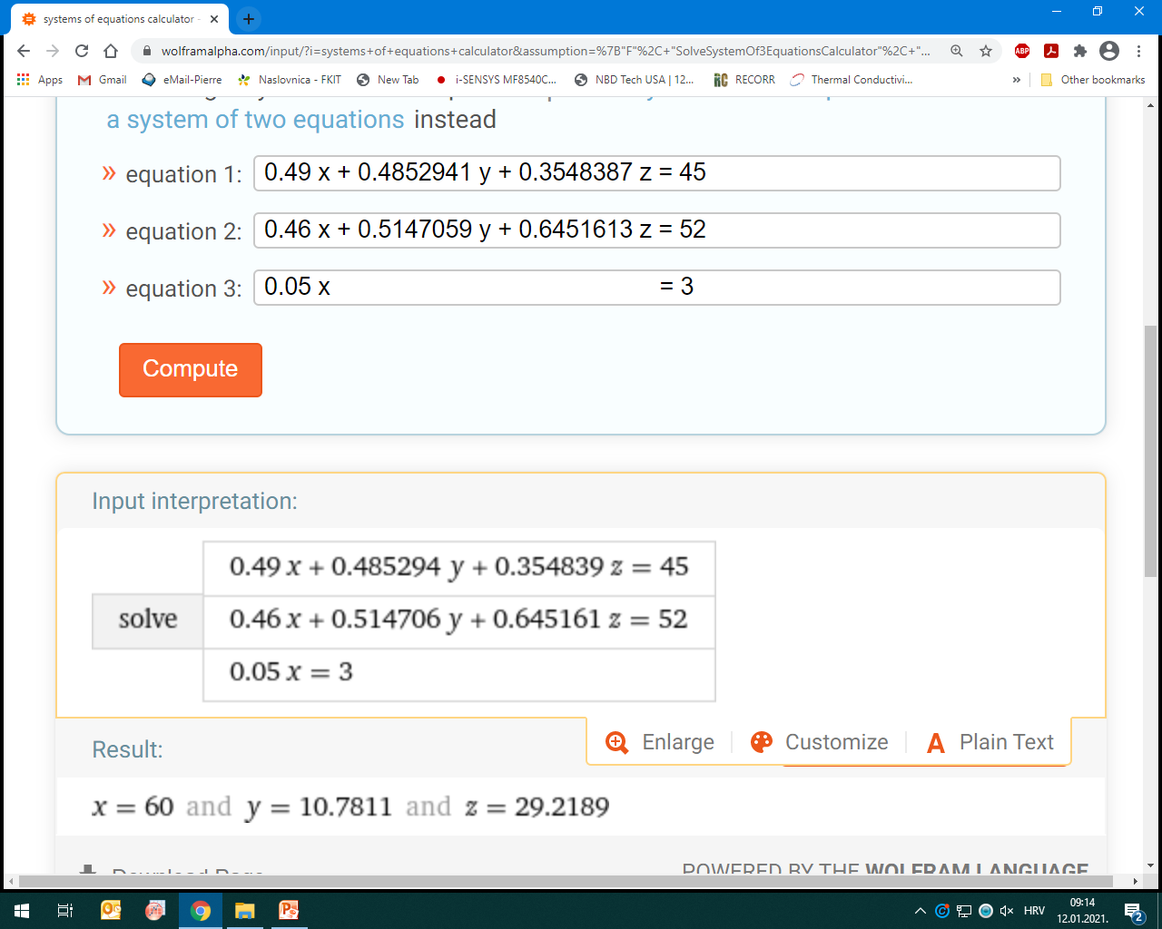

Slide 19
Tijek ravnotežnog hlađenja, talina sastava eutektika (E) u ravnoteži s CA (s) i C₁₂A₇ (s) (ali još nije krenula kristalizacija taline!)

Slide 20
≈ 1370 °C→T→1335 °C (eutektik!)
Sastav eutektika: 49.5% mas. CaO, 43.7%mas. Al₂O₃ i 6.8% mas. SiO₂
T<1370°C
L + CaAl₂O₄ (s) + C₁₂A₇(s)
5% SiO₂
46% Al₂O₃
49% CaO
Ravnotežno hlađenje početne taline „o” završava
u eutektičkoj točci pri temperaturi od 1335 °C
4.2% SiO₂
47.1% Al₂O₃
48.7% CaO
E.
45% CaO
52% Al₂O₃
3% SiO₂
L .
.
o

Slide 21
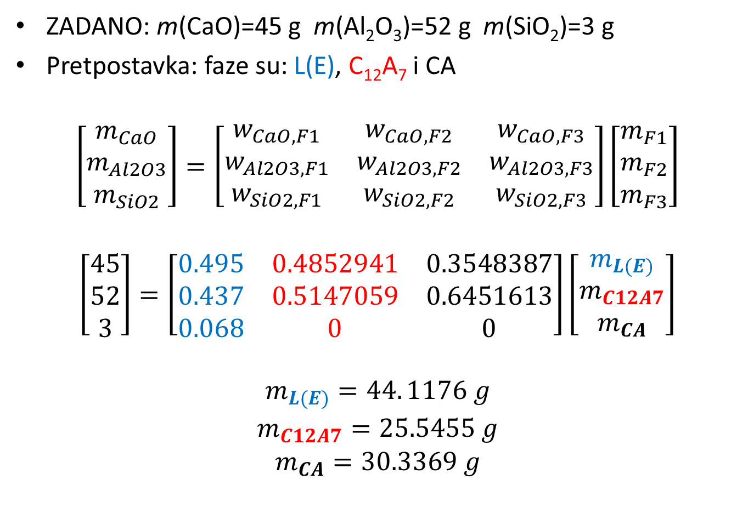
Matrični zapis…
ZADANO: m(CaO)=45 g m(Al₂O₃)=52 g m(SiO₂)=3 g
Pretpostavka: faze su: L(E), C₁₂A₇ i CA
$$\left[\begin{matrix}m_{CaO} \\ m_{Al2O3} \\ m_{SiO2}\end{matrix}\right]=\left[\begin{matrix}w_{CaO,F1} & w_{CaO, F2} & w_{CaO,F3} \\ w_{Al2O3,F1} & w_{Al2O3,F2} & w_{Al2O3,F3} \\ w_{SiO2,F1} & w_{SiO2,F2} & w_{SiO2,F3}\end{matrix}\right]\left[\begin{matrix}m_{F1} \\ m_{F2} \\ m_{F3}\end{matrix}\right]$$
$$\left[\begin{matrix}45 \\ 52 \\ 3\end{matrix}\right]=\left[\begin{matrix}0.495 & 0.4852941 & 0.3548387 \\ 0.437 & 0.5147059 & 0.6451613 \\ 0.068 & 0 & 0\end{matrix}\right]\left[\begin{matrix}m_{L(E)} \\ m_{C12A7} \\ m_{CA}\end{matrix}\right]$$
$$\begin{matrix}m_{L(E)}=44. 1176 g \\ m_{C12A7}=25.5455 g \\ m_{CA}=30.3369 g\end{matrix}$$
$${MASA TALINE IZNOSI m}_{L(E)}=44. 1176 g$$

Slide 22
Koliko (i kojih) mineralnih faza nastaje kristalizacijom taline sastava E ?

Slide 23
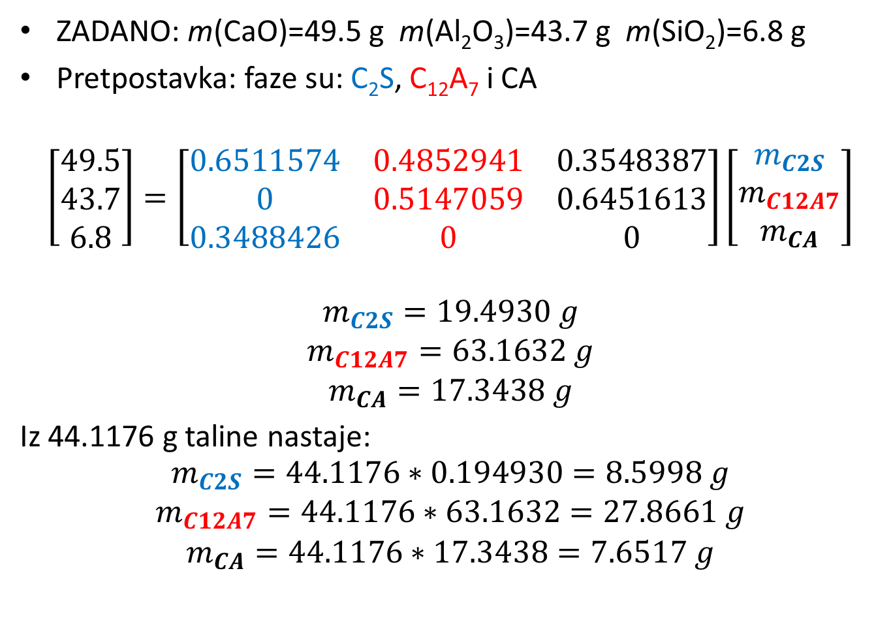
Talina sastava E pripada trokomponentnom podsustavu C₂S-C₁₂A₇-CA
ZADANO: m(CaO)=49.5 g m(Al₂O₃)=43.7 g m(SiO₂)=6.8 g
Pretpostavka: faze su: C₂S, C₁₂A₇ i CA
$$\left[\begin{matrix}49.5 \\ 43.7 \\ 6.8\end{matrix}\right]=\left[\begin{matrix}0.6511574 & 0.4852941 & 0.3548387 \\ 0 & 0.5147059 & 0.6451613 \\ 0.3488426 & 0 & 0\end{matrix}\right]\left[\begin{matrix}m_{C2S} \\ m_{C12A7} \\ m_{CA}\end{matrix}\right]$$
$$\begin{matrix}m_{C2S}=19.4930 g \\ m_{C12A7}=63.1632 g \\ m_{CA}=17.3438 g\end{matrix}$$
Iz 44.1176 g taline nastaje:
$$\begin{matrix}m_{C2S}=44.1176∗0.194930=8.5998 g \\ m_{C12A7}=44.1176∗63.1632=27.8661 g \\ m_{CA}=44.1176∗17.3438=7.6517 g\end{matrix}$$

Slide 24
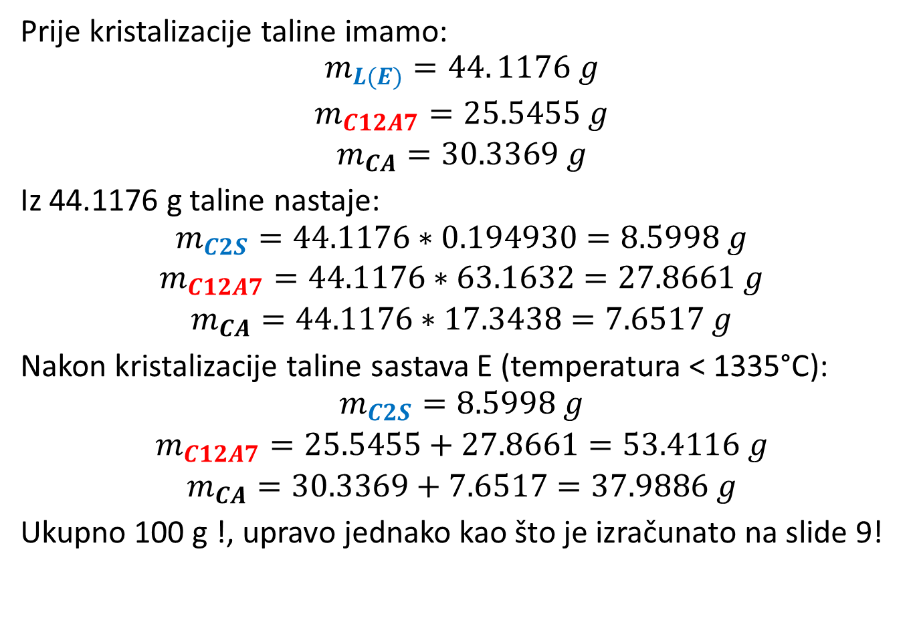
Prije kristalizacije taline imamo:
$$\begin{matrix}m_{L(E)}=44. 1176 g \\ m_{C12A7}=25.5455 g \\ m_{CA}=30.3369 g\end{matrix}$$
Iz 44.1176 g taline nastaje:
$$\begin{matrix}m_{C2S}=44.1176∗0.194930=8.5998 g \\ m_{C12A7}=44.1176∗63.1632=27.8661 g \\ m_{CA}=44.1176∗17.3438=7.6517 g\end{matrix}$$
Nakon kristalizacije taline sastava E (temperatura < 1335°C):
$$\begin{matrix}m_{C2S}=8.5998 g \\ m_{C12A7}=25.5455+27.8661=53.4116 g \\ m_{CA}=30.3369+7.6517=37.9886 g\end{matrix}$$
Ukupno 100 g !, upravo jednako kao što je izračunato na slide 9!

Slide 25
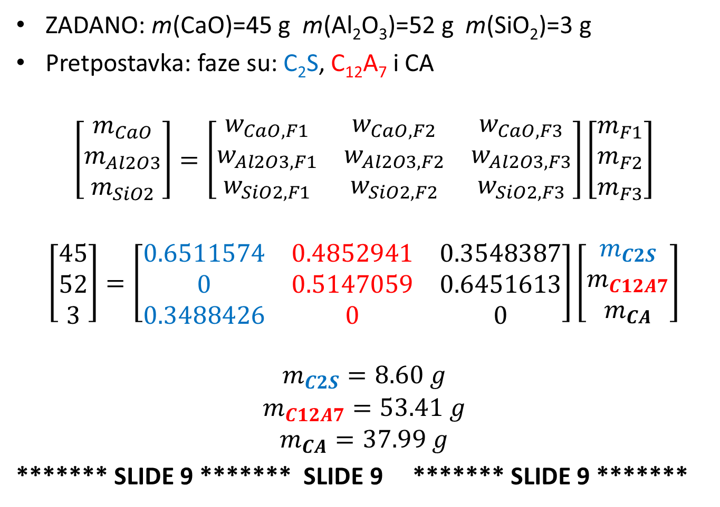
******* SLIDE 9 ******* SLIDE 9 ******* SLIDE 9 *******
ZADANO: m(CaO)=45 g m(Al₂O₃)=52 g m(SiO₂)=3 g
Pretpostavka: faze su: C₂S, C₁₂A₇ i CA
$$\left[\begin{matrix}m_{CaO} \\ m_{Al2O3} \\ m_{SiO2}\end{matrix}\right]=\left[\begin{matrix}w_{CaO,F1} & w_{CaO, F2} & w_{CaO,F3} \\ w_{Al2O3,F1} & w_{Al2O3,F2} & w_{Al2O3,F3} \\ w_{SiO2,F1} & w_{SiO2,F2} & w_{SiO2,F3}\end{matrix}\right]\left[\begin{matrix}m_{F1} \\ m_{F2} \\ m_{F3}\end{matrix}\right]$$
$$\left[\begin{matrix}45 \\ 52 \\ 3\end{matrix}\right]=\left[\begin{matrix}0.6511574 & 0.4852941 & 0.3548387 \\ 0 & 0.5147059 & 0.6451613 \\ 0.3488426 & 0 & 0\end{matrix}\right]\left[\begin{matrix}m_{C2S} \\ m_{C12A7} \\ m_{CA}\end{matrix}\right]$$
$$\begin{matrix}m_{C2S}=8.60 g \\ m_{C12A7}=53.41 g \\ m_{CA}=37.99 g\end{matrix}$$
******* SLIDE 9 ******* SLIDE 9 ******* SLIDE 9 *******

Slide 26
Novi početni sastav je još bogatiji na SiO₂ !

Slide 27
≈1480 °C (talina „o”)→T→ L + CaAl₂O₄ (s)
L₁ 49% Al₂O₃, 6.41% SiO₂ , w(CA)=0.0644, T≈1475 °C
L₂ 48% Al₂O₃, 6.83% SiO₂ , w(CA)=0.1211, T ≈ 1450 °C
L₃ 47% Al₂O₃, 7.24% SiO₂ , w(CA)=0.1713, T ≈ 1440 °C
L₄ 46% Al₂O₃, 7.65% SiO₂ , w(CA)=0.2160, T ≈ 1425 °C
L₅ 45% Al₂O₃, 8.07% SiO₂ , w(CA)=0.2562, T ≈ 1415 °C
L₆ 44% Al₂O₃, 8.48% SiO₂ , w(CA)=0.2924, T ≈ 1403 °C
L₇ 43% Al₂O₃, 8.89% SiO₂ , w(CA)=0.3253, T ≈ 1385 °C
L 42.3% Al₂O₃, 9.18% SiO₂ , w(CA)=0.3466, T≈ 1374 °C
49% CaO
43% Al₂O₃
8% SiO₂
Primjenom pravila poluge moguće je odrediti maseni udio CA(s), C₂S(s) i taline L.
T<≈1374°C
L + CaAl₂O₄ (s) + C₂S (s)
Početni sastav „o” nalazi se unutar trokuta
C₂S-L-CA.
L.
L.
.L₅
44% CaO
50% Al₂O₃
6% SiO₂
E.
.L₄
.L₃
.L₂
.L₁
o

Slide 28
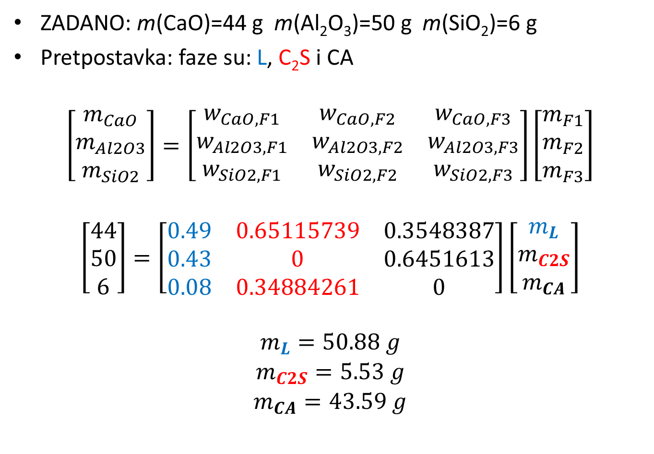
Matrični zapis…
ZADANO: m(CaO)=44 g m(Al₂O₃)=50 g m(SiO₂)=6 g
Pretpostavka: faze su: L, C₂S i CA
$$\left[\begin{matrix}m_{CaO} \\ m_{Al2O3} \\ m_{SiO2}\end{matrix}\right]=\left[\begin{matrix}w_{CaO,F1} & w_{CaO, F2} & w_{CaO,F3} \\ w_{Al2O3,F1} & w_{Al2O3,F2} & w_{Al2O3,F3} \\ w_{SiO2,F1} & w_{SiO2,F2} & w_{SiO2,F3}\end{matrix}\right]\left[\begin{matrix}m_{F1} \\ m_{F2} \\ m_{F3}\end{matrix}\right]$$
$$\left[\begin{matrix}44 \\ 50 \\ 6\end{matrix}\right]=\left[\begin{matrix}0.49 & 0.65115739 & 0.3548387 \\ 0.43 & 0 & 0.6451613 \\ 0.08 & 0.34884261 & 0\end{matrix}\right]\left[\begin{matrix}m_{L} \\ m_{C2S} \\ m_{CA}\end{matrix}\right]$$
$$\begin{matrix}m_{L}=50.88 g \\ m_{C2S}=5.53 g \\ m_{CA}=43.59 g\end{matrix}$$

Slide 29
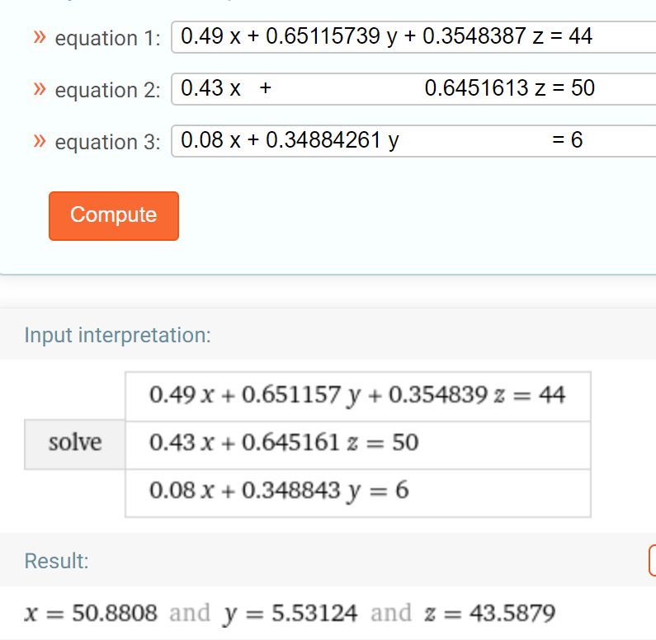

Slide 30
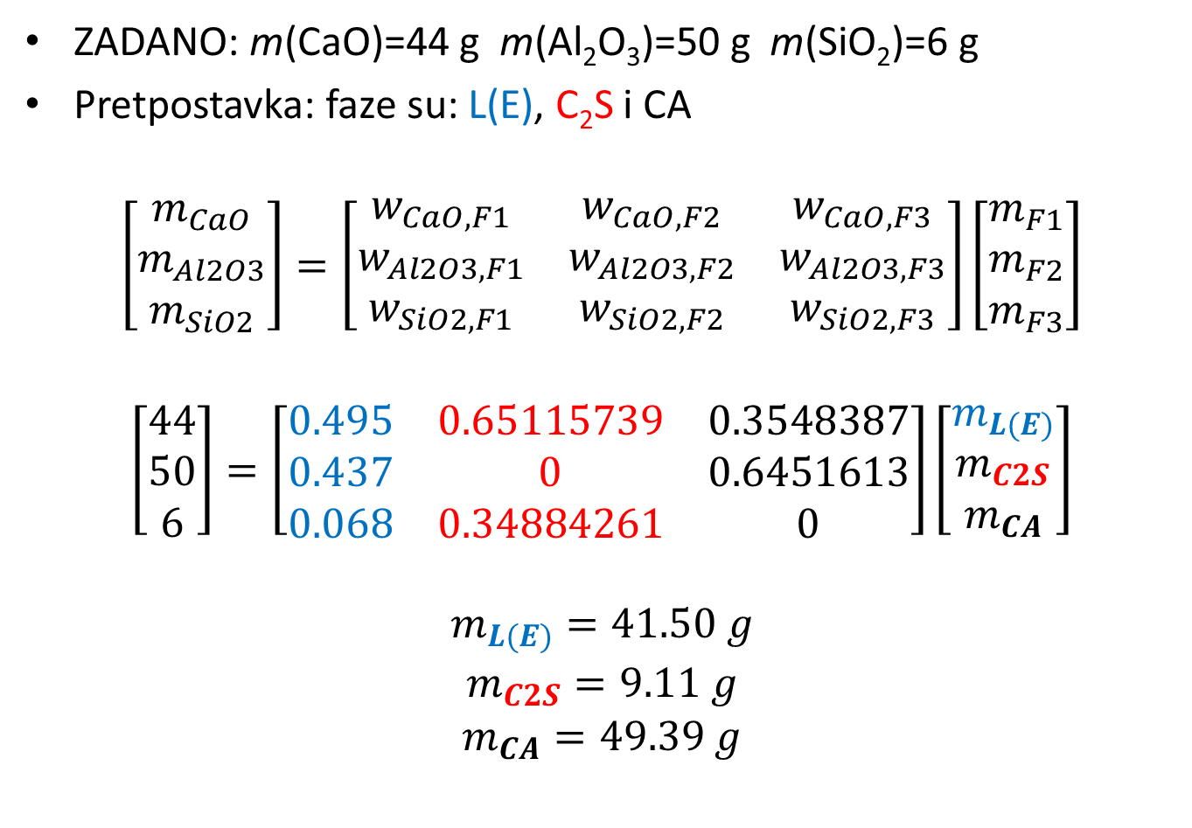
Koliko ima taline sastava E neposredno prije kristalizacije?
ZADANO: m(CaO)=44 g m(Al₂O₃)=50 g m(SiO₂)=6 g
Pretpostavka: faze su: L(E), C₂S i CA
$$\left[\begin{matrix}m_{CaO} \\ m_{Al2O3} \\ m_{SiO2}\end{matrix}\right]=\left[\begin{matrix}w_{CaO,F1} & w_{CaO, F2} & w_{CaO,F3} \\ w_{Al2O3,F1} & w_{Al2O3,F2} & w_{Al2O3,F3} \\ w_{SiO2,F1} & w_{SiO2,F2} & w_{SiO2,F3}\end{matrix}\right]\left[\begin{matrix}m_{F1} \\ m_{F2} \\ m_{F3}\end{matrix}\right]$$
$$\left[\begin{matrix}44 \\ 50 \\ 6\end{matrix}\right]=\left[\begin{matrix}0.495 & 0.65115739 & 0.3548387 \\ 0.437 & 0 & 0.6451613 \\ 0.068 & 0.34884261 & 0\end{matrix}\right]\left[\begin{matrix}m_{L(E)} \\ m_{C2S} \\ m_{CA}\end{matrix}\right]$$
$$\begin{matrix}m_{L(E)}=41.50 g \\ m_{C2S}=9.11 g \\ m_{CA}=49.39 g\end{matrix}$$

Slide 31
Rješenje sustava jednadžbi…
0.495 x + 0.651157 y + 0.354839 z = 44
0.437 x + 0.645161 z = 50
0.068 x + 0.348843 y = 6
x = 41.4992
y = 9.11028
z = 49.3905

Slide 32
Novi sastav nalazi se u polju primarne kristalizacije CaO (s)

Slide 33
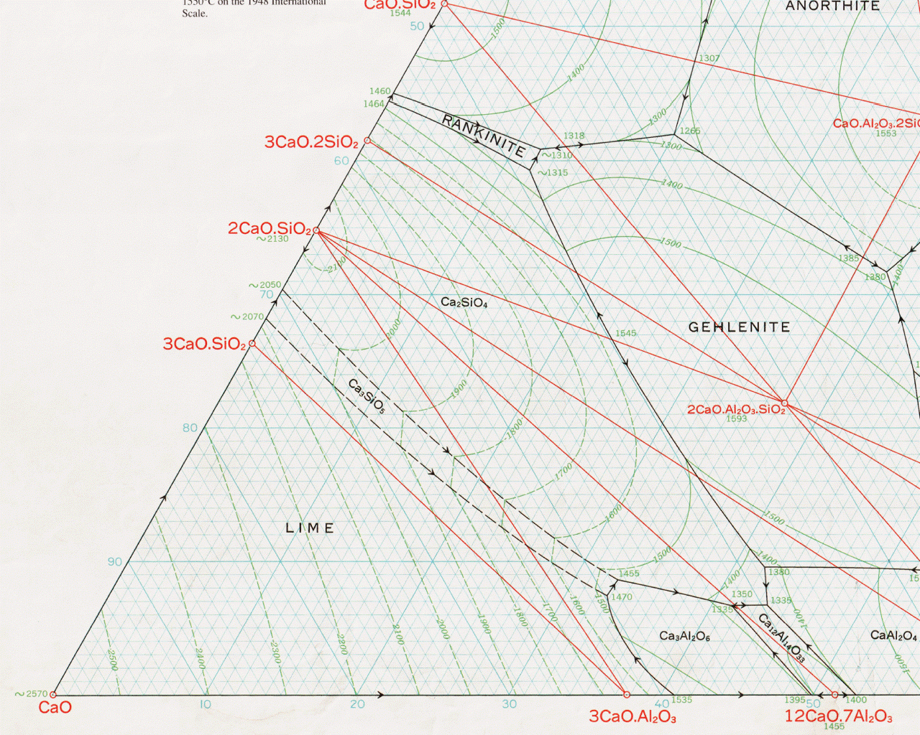
w(C₃S)=(A…o)/(A…C₃S)
w(C₃A)=(B…o)/(B…C₃A)
w(CaO)=(C…o)/(C…CaO)
B .
. C
o
78% CaO
8% Al₂O₃
14% SiO₂
. A
Notes:
14% SiO2

Slide 34
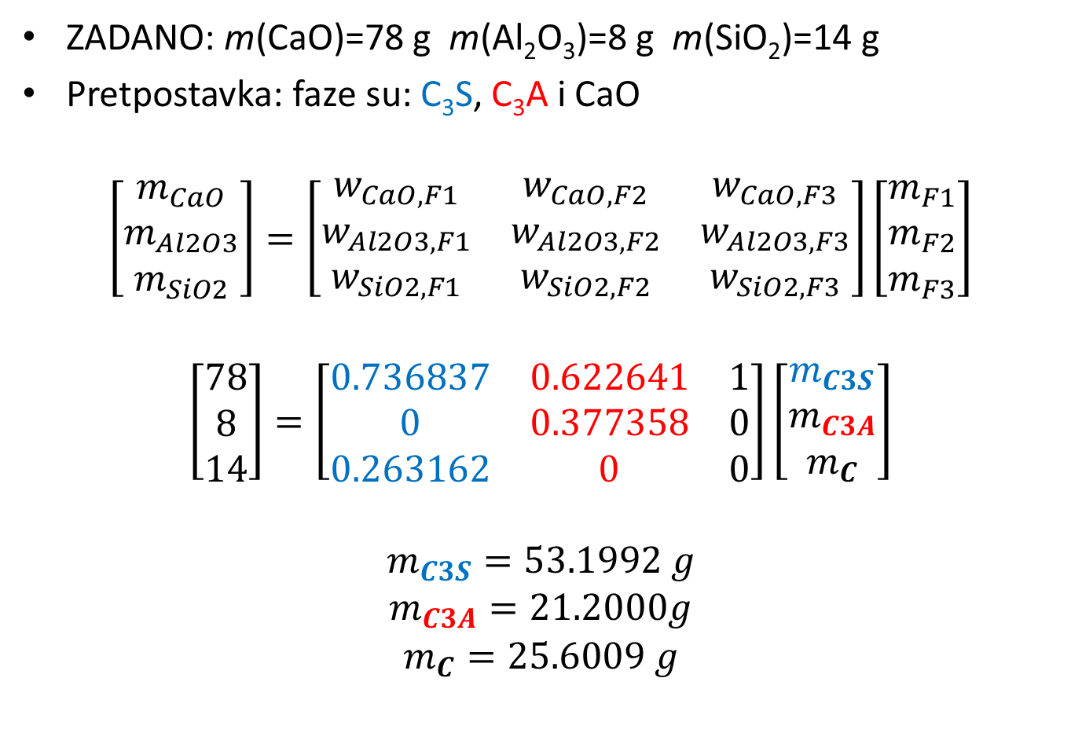
Matrični zapis…
ZADANO: m(CaO)=78 g m(Al₂O₃)=8 g m(SiO₂)=14 g
Pretpostavka: faze su: C₃S, C₃A i CaO
$$\left[\begin{matrix}m_{CaO} \\ m_{Al2O3} \\ m_{SiO2}\end{matrix}\right]=\left[\begin{matrix}w_{CaO,F1} & w_{CaO, F2} & w_{CaO,F3} \\ w_{Al2O3,F1} & w_{Al2O3,F2} & w_{Al2O3,F3} \\ w_{SiO2,F1} & w_{SiO2,F2} & w_{SiO2,F3}\end{matrix}\right]\left[\begin{matrix}m_{F1} \\ m_{F2} \\ m_{F3}\end{matrix}\right]$$
$$\left[\begin{matrix}78 \\ 8 \\ 14\end{matrix}\right]=\left[\begin{matrix}0.736837 & 0.622641 & 1 \\ 0 & 0.377358 & 0 \\ 0.263162 & 0 & 0\end{matrix}\right]\left[\begin{matrix}m_{C3S} \\ m_{C3A} \\ m_{C}\end{matrix}\right]$$
$$\begin{matrix}m_{C3S}=53.1992 g \\ m_{C3A}=21.2000g \\ m_{C}=25.6009 g\end{matrix}$$

Slide 35
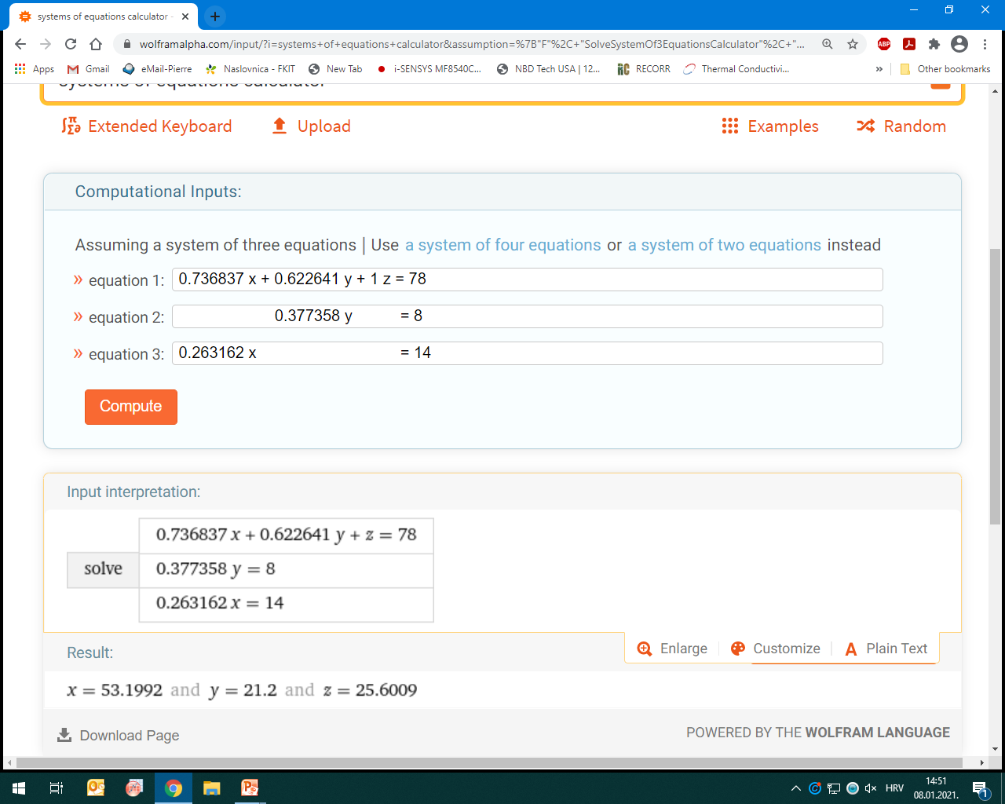

Slide 36
T > 2230 °C talina (liquid)
T< 2230 °C (Liquid) + CaO(s)
T = 2200 °C (Liquid) + CaO(s)
14.8% SiO₂
8.4% Al₂O₃
76.8% CaO
T→1470°C, točka „P”
→CaO(s) + C₃S(s) + L(P)
→CaO(s) + C₃S(s) + C₃A(s)
C₃A(s) (i C₃S) nastju reakcijom
CaO(s) i L pri 1470 °C
w(CaO(s), 2200°C)=(L…o)/(L…CaO)
w((L), 2200°C)=(CaO…o)/(CaO…L)
. L
→CaO(s) + L m(L)=70g, m(CaO(s))=30g
A .
. L
→CaO(s) + C₃S(s) + L
o
1600 °C, CaO(s)+C₃S(s)+L
L: 10%SiO₂, 27.8%Al₂O₃, 62.2%CaO
. L
78% CaO
8% Al₂O₃
14% SiO₂
. P
w(L, 1600°C)=(A…o)/(A…L)=28.77%
59.8% CaO
32.8% Al₂O₃
7.4% SiO₂

Slide 37
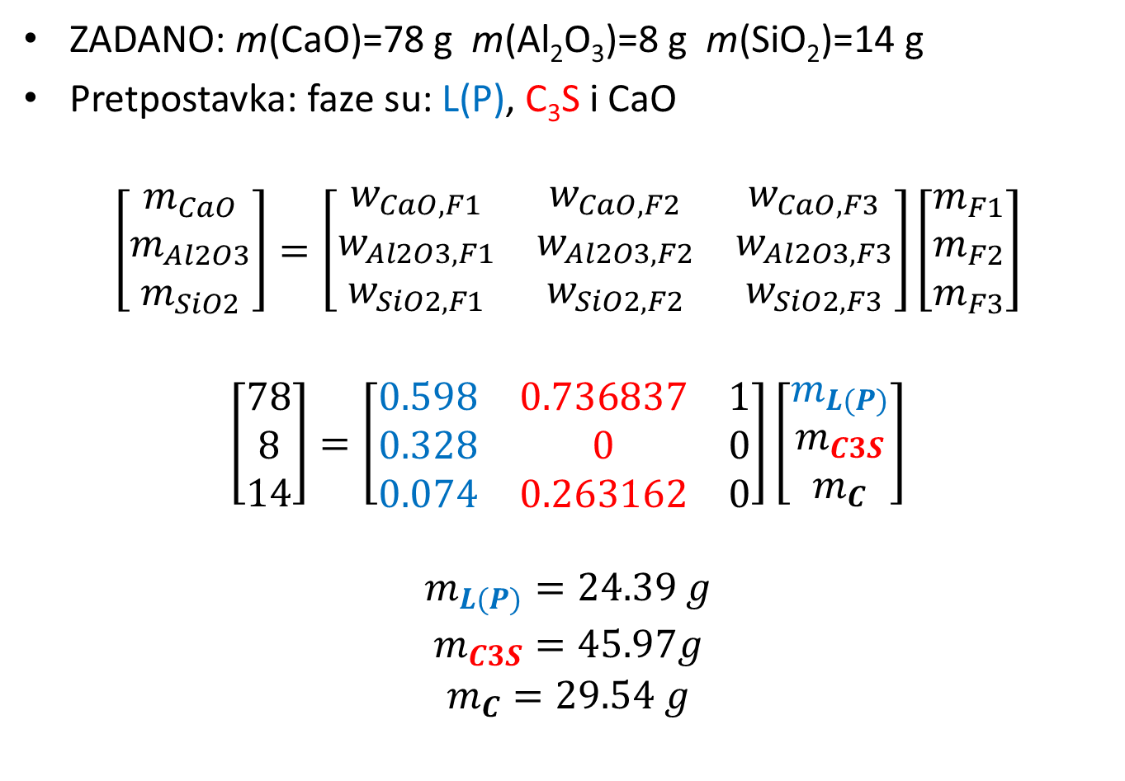
Matrični zapis…
ZADANO: m(CaO)=78 g m(Al₂O₃)=8 g m(SiO₂)=14 g
Pretpostavka: faze su: L(P), C₃S i CaO
$$\left[\begin{matrix}m_{CaO} \\ m_{Al2O3} \\ m_{SiO2}\end{matrix}\right]=\left[\begin{matrix}w_{CaO,F1} & w_{CaO, F2} & w_{CaO,F3} \\ w_{Al2O3,F1} & w_{Al2O3,F2} & w_{Al2O3,F3} \\ w_{SiO2,F1} & w_{SiO2,F2} & w_{SiO2,F3}\end{matrix}\right]\left[\begin{matrix}m_{F1} \\ m_{F2} \\ m_{F3}\end{matrix}\right]$$
$$\left[\begin{matrix}78 \\ 8 \\ 14\end{matrix}\right]=\left[\begin{matrix}0.598 & 0.736837 & 1 \\ 0.328 & 0 & 0 \\ 0.074 & 0.263162 & 0\end{matrix}\right]\left[\begin{matrix}m_{L(P)} \\ m_{C3S} \\ m_{C}\end{matrix}\right]$$
$$\begin{matrix}m_{L(P)}=24.39 g \\ m_{C3S}=45.97g \\ m_{C}=29.54 g\end{matrix}$$

Slide 38
Što se događa pri 1470°C (peritektička točka, P)?
Masa taline, L(P) pri 1470°C u ravnoteži s CaO(s) i C₃S(s) je 24.39 g. Maseni udio Al₂O₃ u talini je 32.8% (peritektička točka, P). Ukupna masa Al₂O₃ u talini je: 24.39g*0.328 = 8.00 g Al₂O₃ (zapravo sva masa Al₂O₃ u početnom uzorku „o”, zato jer CaO i C₃S ne sadrže Al₂O₃). Pri još sasvim malom padu temperature dolazi do peritek-tičke reakcije između taline i čvrste faze! U ovom slučaju, u peritek-tičkoj točci reagira CaO(s) i talina dajući C₃A(s) i C₃S(s).
Masa C₃A(s) koji nastaje (utroši se sav Al₂O₃):
m(C₃A(s))= M(C₃A)*n(Al₂O₃)=(3*56.078+101.96)*n(Al₂O₃)=
m(C₃A(s))=270.194*8/101.96 = 21.2 g

Slide 40
Ravnotežni podsustav C₁₂A₇-CA-C₂S
Eutektička točka pri 1335 °C
Sastav: 49.5% mas. CaO
43.7% mas. Al₂O₃
6.8% mas. SiO₂
Peritektička točka pri 1380 °C
Sastav: 48.3% mas. CaO
42.1% mas. Al₂O₃
9.6% mas. SiO₂

Slide 41
https://www.wolframalpha.com/input/?i=systems+of+equations+calculator&assumption=%7B%22F%22%2C+%22SolveSystemOf3EquationsCalculator%22%2C+%22equation1%22%7D+-%3E%220.6511574+x+%2B+0.4852941+y+%2B+0.3548387+z+%3D+49.5%22&assumption=%22FSelect%22+-%3E+%7B%7B%22SolveSystemOf3EquationsCalculator%22%7D%7D&assumption=%7B%22F%22%2C+%22SolveSystemOf3EquationsCalculator%22%2C+%22equation2%22%7D+-%3E%22+++++++++++++++++++++++0.5147059+y+%2B+0.6451613+z+%3D+43.7%22&assumption=%7B%22F%22%2C+%22SolveSystemOf3EquationsCalculator%22%2C+%22equation3%22%7D+-%3E%220.3488426+x++++++++++++++++++++++++++++++++++++++++++++++++%3D+6.8%22
Reduce
0.651157 x + 0.485294 y + 0.354839 z = 49.5
0.514706 y + 0.645161 z = 43.7
0.348843 x = 6.8
x = 19.493 and y = 63.1632 and z = 17.3438

